Slide 1
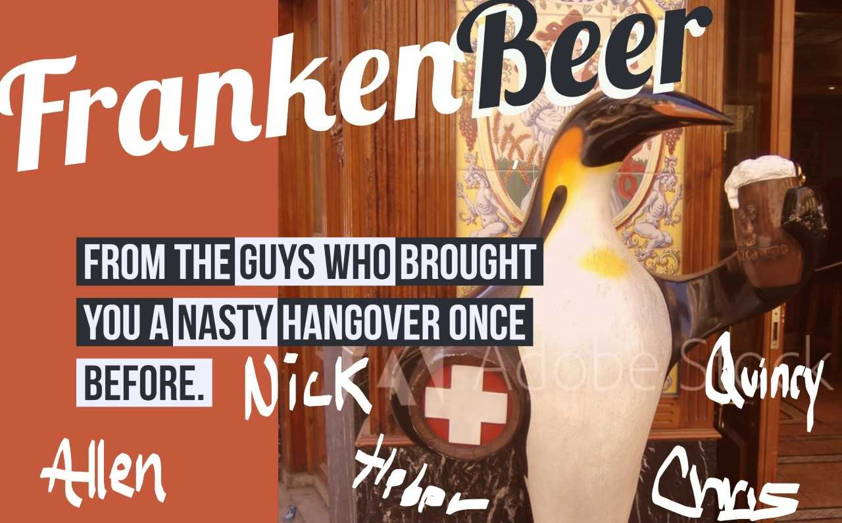

Slide 2
Agenda
Introduction
Market Backdrop
Meet FrankenBeer
Where do we go from here?
Initial Market Research
Expansion Market Proposal
Conclusion

Slide 3
Introduction
The Team
Allen Crane
Nick Cellini
Chris Graves
Heber Nielsen
Quincy Roundtree
The Purpose
Evaluate the microbrewery landscape in the US and recommend expansion markets for our FrankenBeer

Slide 4
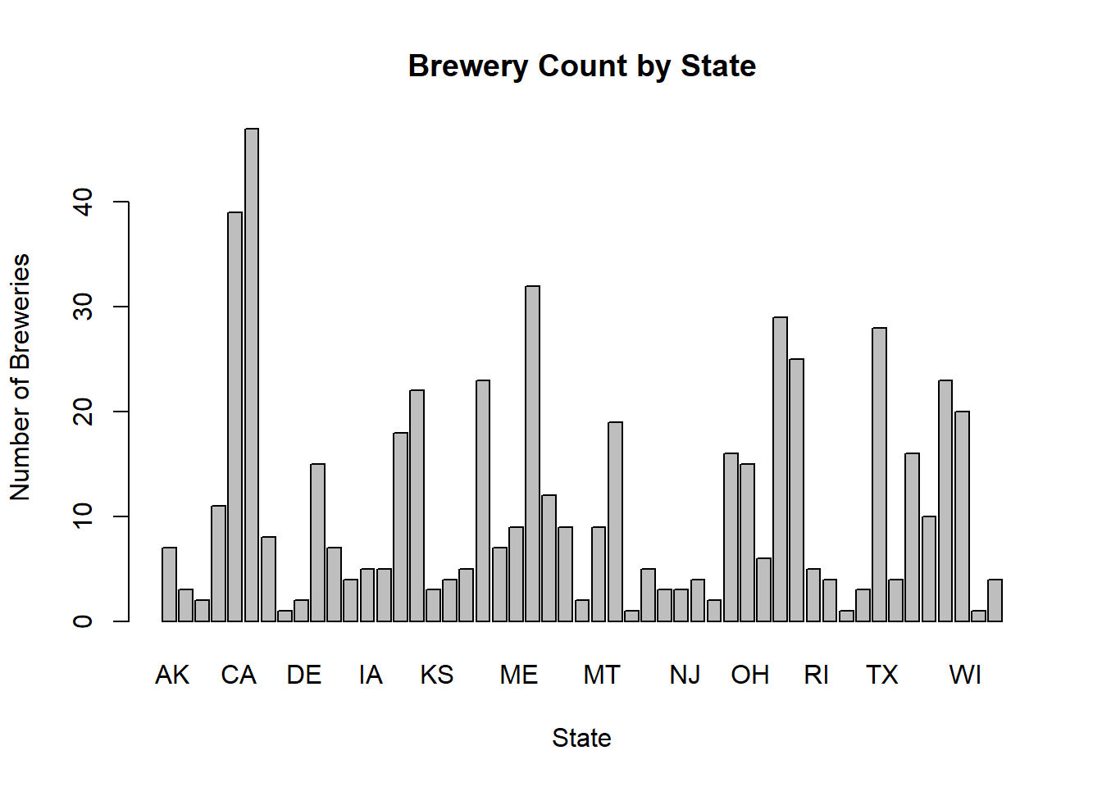
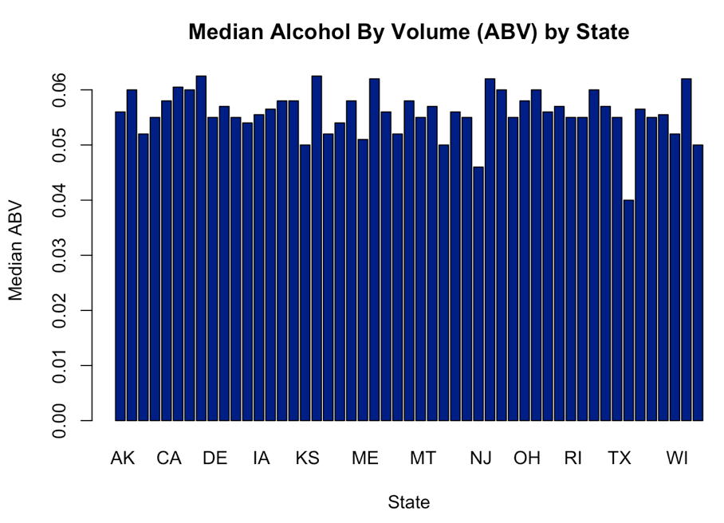
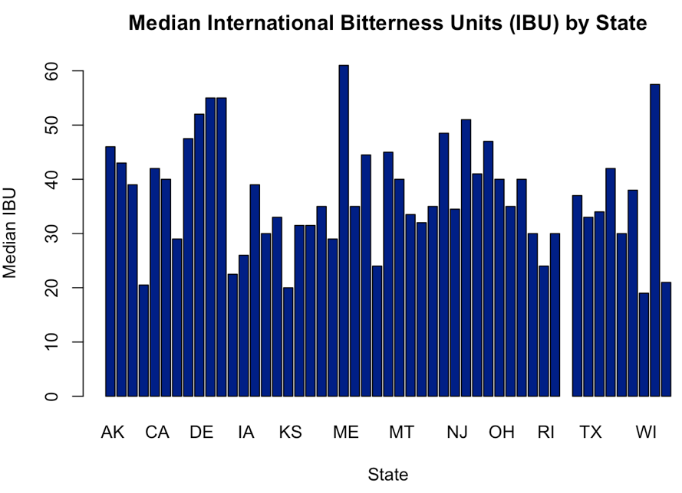
Market Backdrop
The crowded Microbrew landscape continues to expand with 558 Breweries offering a proliferating selection of 2,410 beers across the domestic US market
The distribution of Breweries by state is highly variable with concentrations in Colorado, California, and Michigan - homes of “old guard” national brands and brews
While median alcohol content (ABV) is solidly clustered in the 5% to 6% range across markets, bitterness (IBU) is much more variable

Slide 5
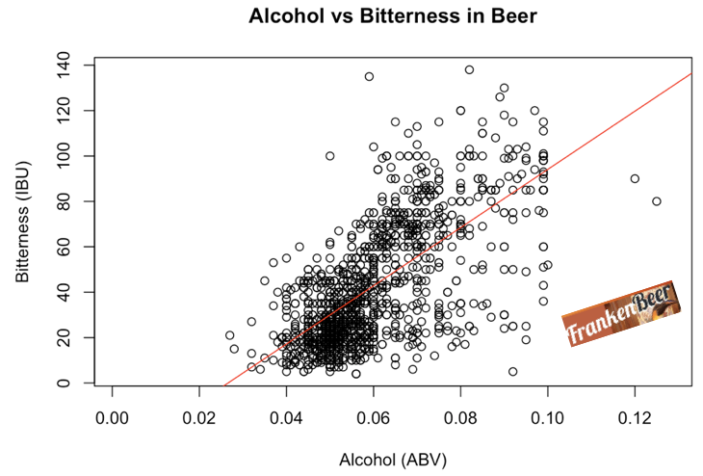
Meet FrankenBeer!
FrankenBeer was created to address a perceived ‘untapped’ demand for the crisp taste of high alcohol content beer without the bitterness which accompanies existing product offerings in this segment.
Our beer scientists have created a novel brewing technique enabling us to deliver 12% ABV at only 33 IBU’s
The ABRAcadabraTM process (Alcohol Bitterness Reduction & Abatement) has performed well within our dedicated team of full time tasters AND in initial test markets across multiple levels of ABV

Slide 6
Where do we go from here?
Our FrankenBeer has distinct qualities that make it appealing customers who enjoy strong beers but dislike bitterness
The ABRAcadabraTM process provides Franken Brewery a low-bitterness competitive advantage which extends across all alcohol content levels
The Franken brewery seeks to begin distribution of FrankenBeer in three new states where it can most effectively bring this competitive advantage to bear

Slide 7
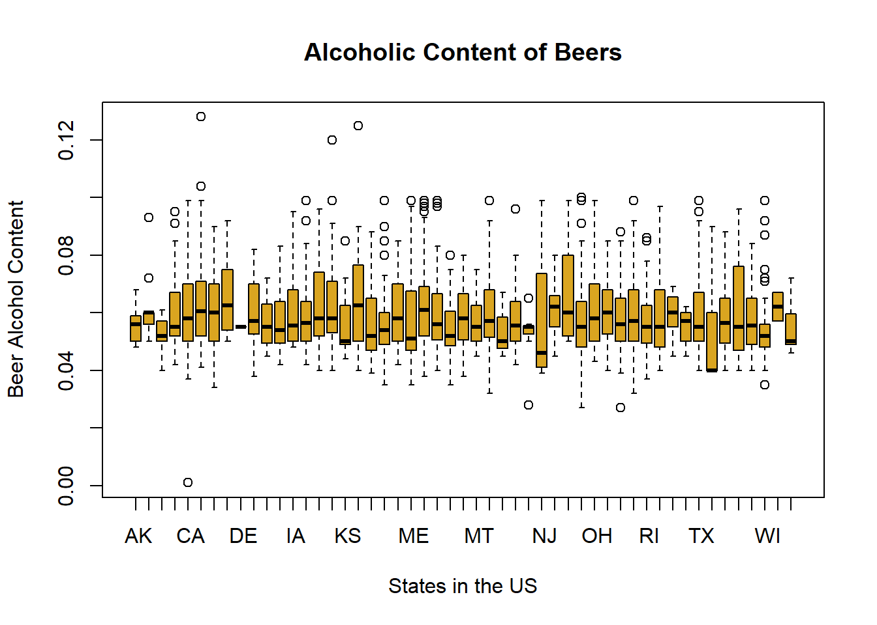
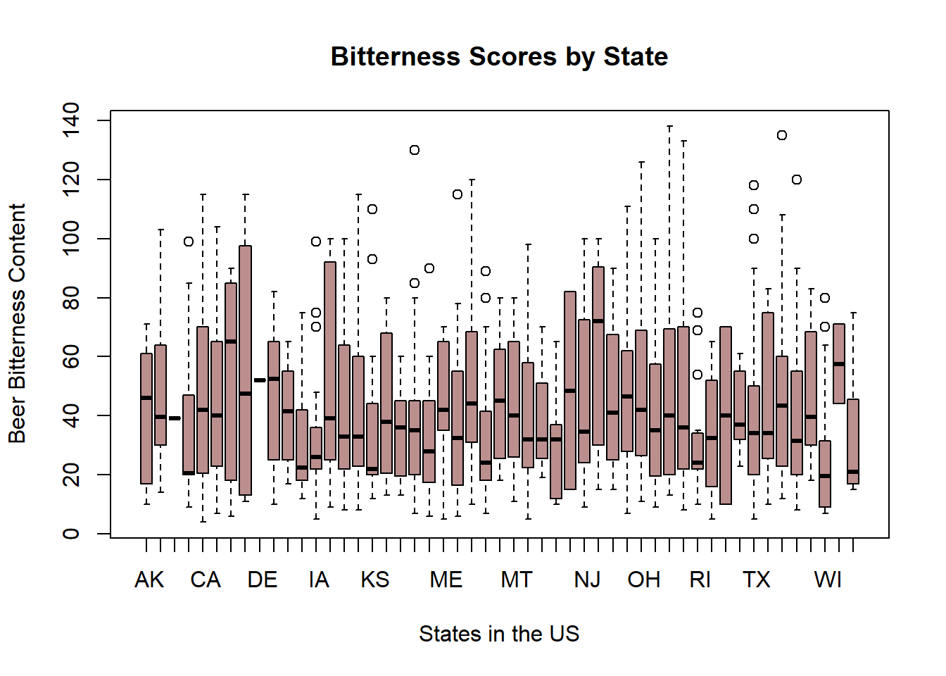
Initial Market Research
The first phase of our work centered on our analysis of the US microbreweries by state. Of particular interest was the Alcohol and Bitterness in the different beer varieties found in each area.
Initial testing has been done in the Seattle, Washington and Boulder, Colorado markets with much success.
Colorado already has the highest ABV craft beer in the country--Lee Hill Series Vol. 5 - Belgian Style Quadrupel Ale (ABV 12.8%)

Slide 8
Expansion Market Proposal
To assist with target market identification, our data scientists (in a flash of brilliance) have created the FrankenScoreTM which is the product of the median ABV by state and the median IBU by state
This metric sizes the relative advantage Franken’s new proprietary technique might have
WV, NM, & FL were identified as having the highest market potential
 | Seattle | Boulder | West Virginia | New Mexico | Florida
Median ABV | 6.35% | 5.95% | 6.20% | 6.20% | 5.70%
Median IBU | 75 | 31 | 57.5 | 51 | 55
FrankenScoreTM | 4.7625 | 1.8445 | 3.57 | 3.16 | 3.14
FrankenRankTM (By State) | N/A | N/A | #1 | #2 | #3

Slide 9
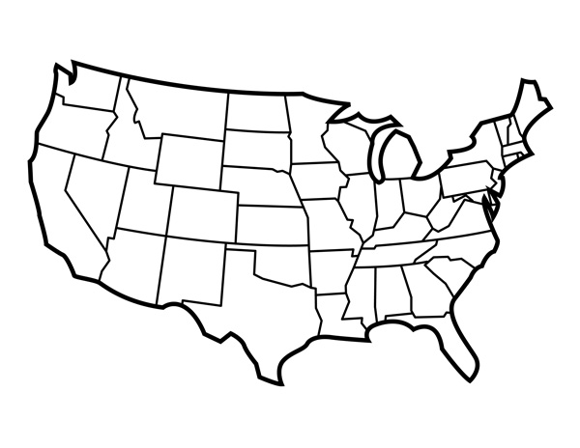
Conclusion
Our FrankenBeer has distinct qualities that make it appealing to many demographics of beer drinkers. Initial testing has been done in the Seattle, Washington and Boulder, Colorado markets with much success.
West Virginia, New Mexico, and Florida represent the top three markets in terms of median bitterness by alcohol content
With its high octane ABV of 12% and its subtle IBU of 33, we believe our FrankenBeer will make its mark in these new markets.

Slide 10
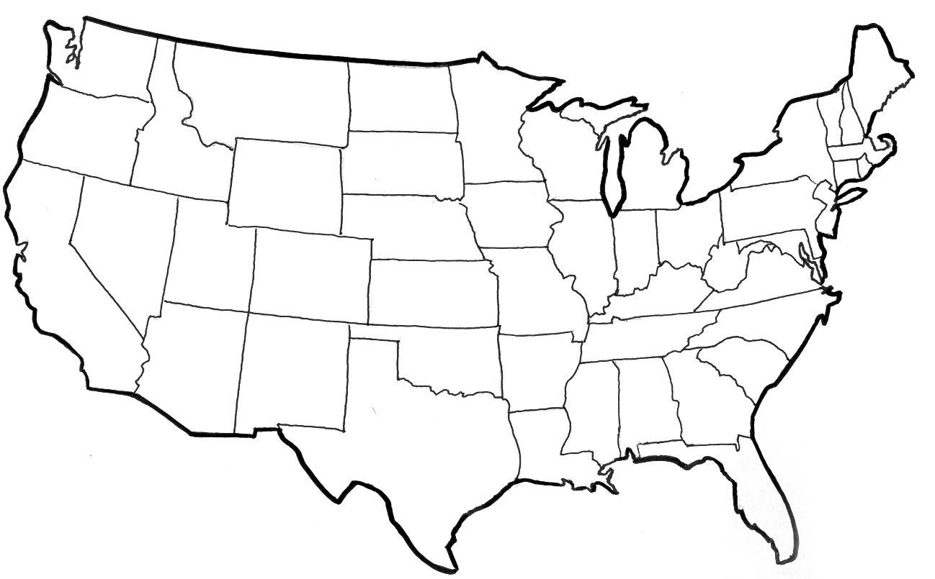
Conclusion
Our FrankenBeer has distinct qualities that make it appealing to many demographics of beer drinkers. Initial testing has been done in the Seattle, Washington and Boulder, Colorado markets with much success.
San Antonio, Texas; Salt Lake City, Utah; and Boston, Massachusetts all have a different craft beer presence, but none like our FrankenBeer.
With its relatively high ABV of 12% and its reltively mild IBU of 33, we believe our FrankenBeer will leave its mark in these new markets.

